Slide 1
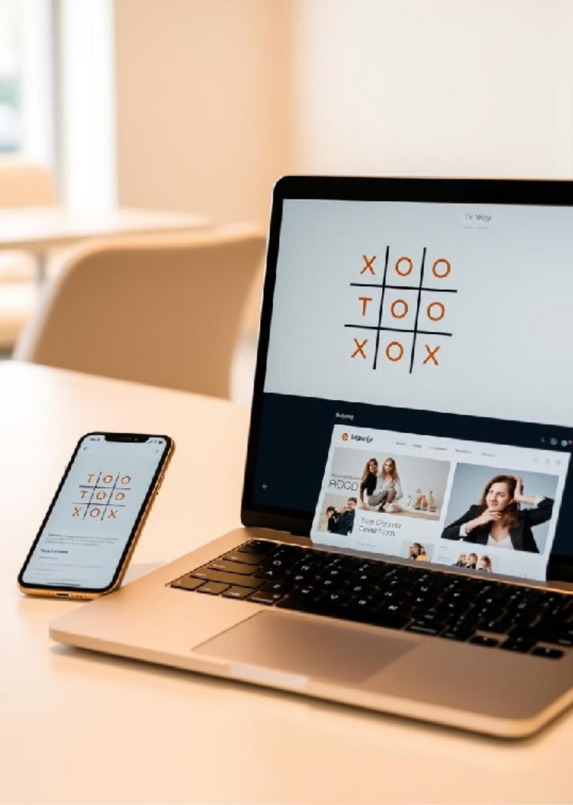
Tic-Tac-Toe & My Portfolio: A Web Development Showcase
This presentation showcases two web development projects: a classic Tic-Tac- Toe game and a personal portfolio website. Both projects utilize HTML, CSS, and JavaScript, demonstrating my coding skills and project development experience. These projects highlight my ability to create interactive and engaging web applications, showcasing my passion for web development and commitment to building high-quality, user-friendly websites.
by Mandadi Rohit Reddy
Internship ID: UMIP278665
M R

Slide 2
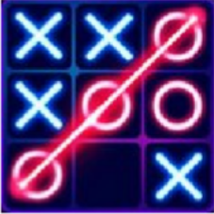

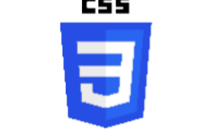

Tic-Tac-Toe: Game Logic & Implementation
HTML Structure
The game board is built using a 3x3 grid, implemented using either `` or `` elements, depending on preference. Each square represents a possible move in the game.
CSS Styling
CSS is used to design the game board's visual appearance, including the grid layout, square dimensions, and the styling of the 'X' and 'O' symbols.
JavaScript Logic
JavaScript handles the game's logic, managing player turns, updating the game board state, and checking for winning conditions. It also detects a draw or tie game and enables the player to reset the game.
https://tubular-speculoos-8d8fbc.netlify.app/

Slide 3

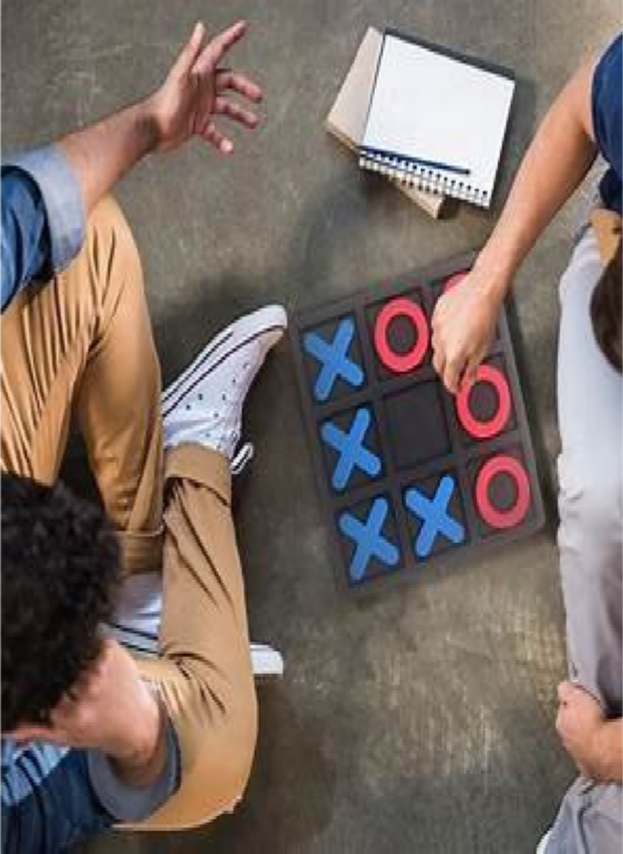

Tic-Tac-Toe: Core JavaScript Functions
1
handleClick(square)
This function handles clicks on the game board. It updates the game board array, visually displays the player's symbol, and calls the `checkWin()` function to see if the current move resulted in a win.
2
checkWin()
This function determines if a player has won the game. It checks all possible winning combinations - rows, columns, and diagonals - and returns
`true` if a win is found, `false` otherwise.
3
resetGame()
This function resets the game board to its initial state. It clears the game board array, visually resets the board on the webpage, and resets the turn counter.
https://tubular-speculoos- 8d8fbc.netlify.app

Slide 4
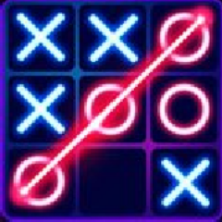
Tic-Tac-Toe: Enhancements & Challenges
AI Opponent
Minimax Algorithm
Challenges Faced
A simple AI opponent can be implemented using `Math.random()`, which randomly selects a square to place its symbol. This creates a basic opponent with unpredictable moves.
For a more advanced and unbeatable AI, the Minimax algorithm can be utilized. This algorithm explores all possible future game states, making optimal moves to guarantee a win or at least a draw.
Challenges during development included optimizing the win condition check, handling edge cases, and improving the AI's decision-making to create a more challenging opponent.
https://tubular-speculoos-8d8fbc.netlify.app

Slide 5
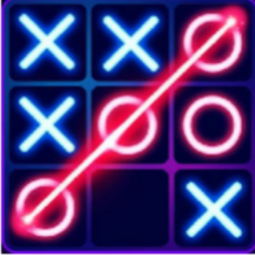
Coding: game.js
console.log("Welcome to Tic Tac Toe") let music = new Audio("music.mp3") let audioTurn = new Audio("ting.mp3")
let gameover = new Audio("gameover.mp3") let turn = "X"
let isgameover = false;
// Function to change the turn const changeTurn = ()=>{
return turn === "X"? "0": "X"
}
// Function to check for a win const checkWin = ()=>{
let boxtext = document.getElementsByClassName('boxtext'); let wins = [
[0, 1, 2, 5, 5, 0],
[3, 4, 5, 5, 15, 0],
[6, 7, 8, 5, 25, 0],
[0, 3, 6, -5, 15, 90],
[1, 4, 7, 5, 15, 90],
[2, 5, 8, 15, 15, 90],
[0, 4, 8, 5, 15, 45],
[2, 4, 6, 5, 15, 135],
]
wins.forEach(e =>{
if((boxtext[e[0]].innerText === boxtext[e[1]].innerText) && (boxtext[e[2]].innerText === boxtext[e[1]].innerText) && (boxtext[e[0]].innerText !== "") ){
document.querySelector('.info').innerText = boxtext[e[0]].innerText + " Won" isgameover = true
document.querySelector('.imgbox').getElementsByTagName('img')[0].style.width = "200px"; document.querySelector(".line").style.transform = `translate(${e[3]}vw, ${e[4]}vw) rotate(${e[5]}deg)` document.querySelector(".line").style.width = "20vw";
}
})
}
// Game Logic
// music.play()
let boxes = document.getElementsByClassName("box"); Array.from(boxes).forEach(element =>{
let boxtext = element.querySelector('.boxtext'); element.addEventListener('click', ()=>{
if(boxtext.innerText === ''){ boxtext.innerText = turn; turn = changeTurn(); audioTurn.play(); checkWin();
if (!isgameover){
document.getElementsByClassName("info")[0].innerText = "Turn for " + turn;
}
}
})
})
// Add onclick listener to reset button reset.addEventListener('click', ()=>{
let boxtexts = document.querySelectorAll('.boxtext'); Array.from(boxtexts).forEach(element => {
element.innerText = ""
});
turn = "X"; isgameover = false
document.querySelector(".line").style.width = "0vw"; document.getElementsByClassName("info")[0].innerText = "Turn for " + turn; document.querySelector('.imgbox').getElementsByTagName('img')[0].style.width = "0px"
})

Slide 6

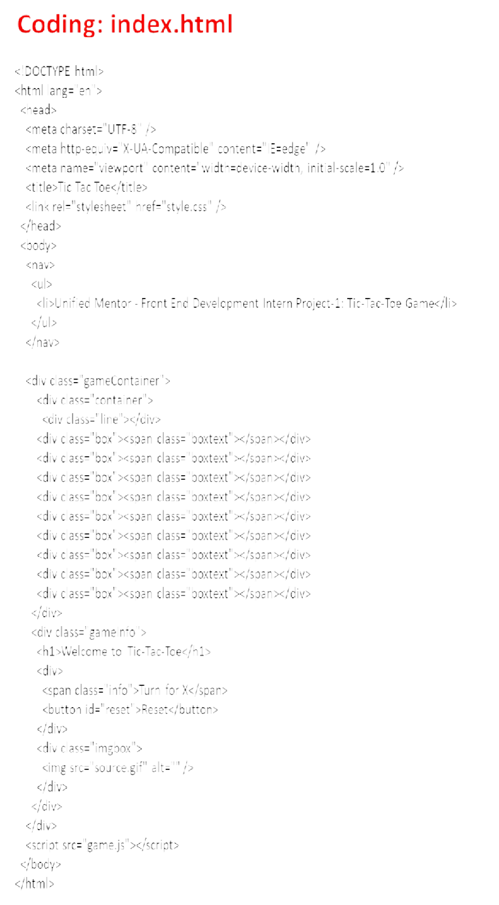
Coding: Style.css
.box:hover{
background-color: rgb(36, 74, 228);
}
#reset {
margin: 0 23px; padding: 1px 18px; background: #9d5bbe; text-align: center; color: white;
border: none; border-radius: 6px; cursor: pointer;
@import url('https://fonts.googleapis.com/css2?fa mily=Baloo+Bhaina+2&family=Roboto&di splay=swap');
*{
margin: 0;
padding: 0;
}
nav{
background-color: rgb(26, 209, 38);
color: rgb(222, 24, 24); height: 65px;
font-size: 27px; display: flex;
align-items: center; padding: 0 12px;
font-family: 'Roboto', sans-serif;
}
nav ul{
list-style-type: none;
}
.gameContainer{ display: flex;
justify-content: center; margin-top: 50px; background-color: yellow;
}
.container{ display: grid;
grid-template-rows: repeat(3, 10vw); grid-template-columns: repeat(3,
10vw);
font-family: 'Roboto', sans-serif; position: relative;
}
.box{
border: 2px solid black; font-size: 8vw;
cursor: pointer; display: flex;
justify-content: center; align-items: center;
}
.info {
font-size: 40px;
}
.gameInfo{ padding: 0 34px;
font-family: 'Baloo Bhaina 2', cursive;
}
font-family: 'Baloo Bhaina 2'; font-size: 15px;
font-weight: bolder;
.gameInfo h1{
font-size: 2.5rem;
}
}
.line{
background-color: black; height: 3px;
width: 0;
position: absolute; background-color: blue;
}
.imgbox img{ width: 0;
transition: width 1s ease-in-out;
}
.br-0{
border-right: 0;
}
.bl-0{
border-left: 0;
}
.bt-0{
border-top: 0;
}
.bb-0{
border-bottom: 0;
}
https://tubular-speculoos-8d8fbc.netlify.app

Slide 7
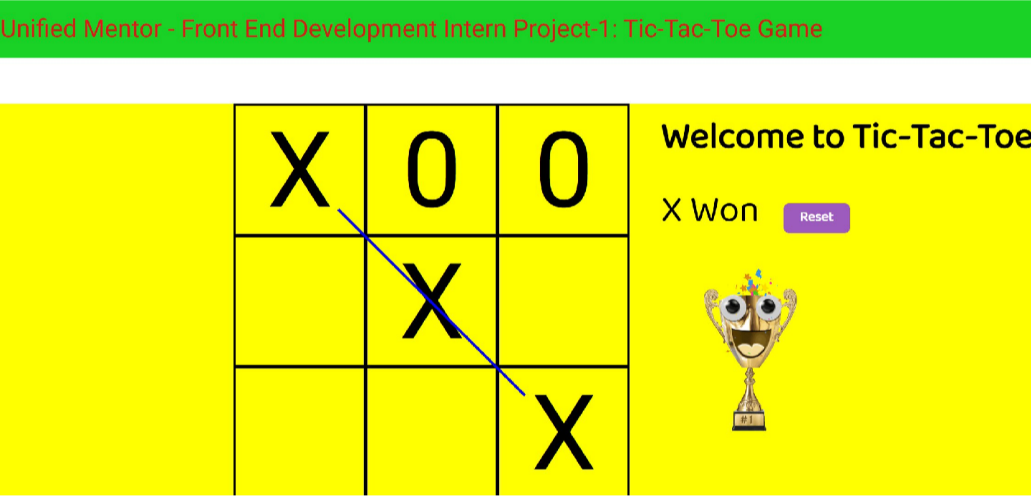
Output Web Page Link: https://tubular-speculoos-8d8fbc.netlify.app
https://tubular-speculoos- 8d8fbc.netlify.app/

Slide 8
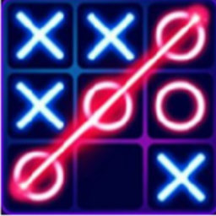
Tic-Tac-Toe.mp4 (Functionality Video)

Slide 9


My Portfolio Website: Design & Structure
Purpose
HTML Structure
CSS Styling
The portfolio website's purpose is to showcase my projects, skills, and experience in web development. It serves as a platform for potential employers or clients to learn about my capabilities.
The website's structure is organized using a navigation bar for easy navigation between sections, including ‘Home‘ , 'About Me', 'Skills', 'Projects', and 'Contact'. A footer contains copyright information and links to social media profiles.
CSS is used to style the website, ensuring responsiveness across various screen sizes, maintaining a consistent color scheme and typography. CSS frameworks such as Bootstrap or Tailwind CSS may be used to speed up development.
https://tubular-dango-96730a.netlify.app/

Slide 10
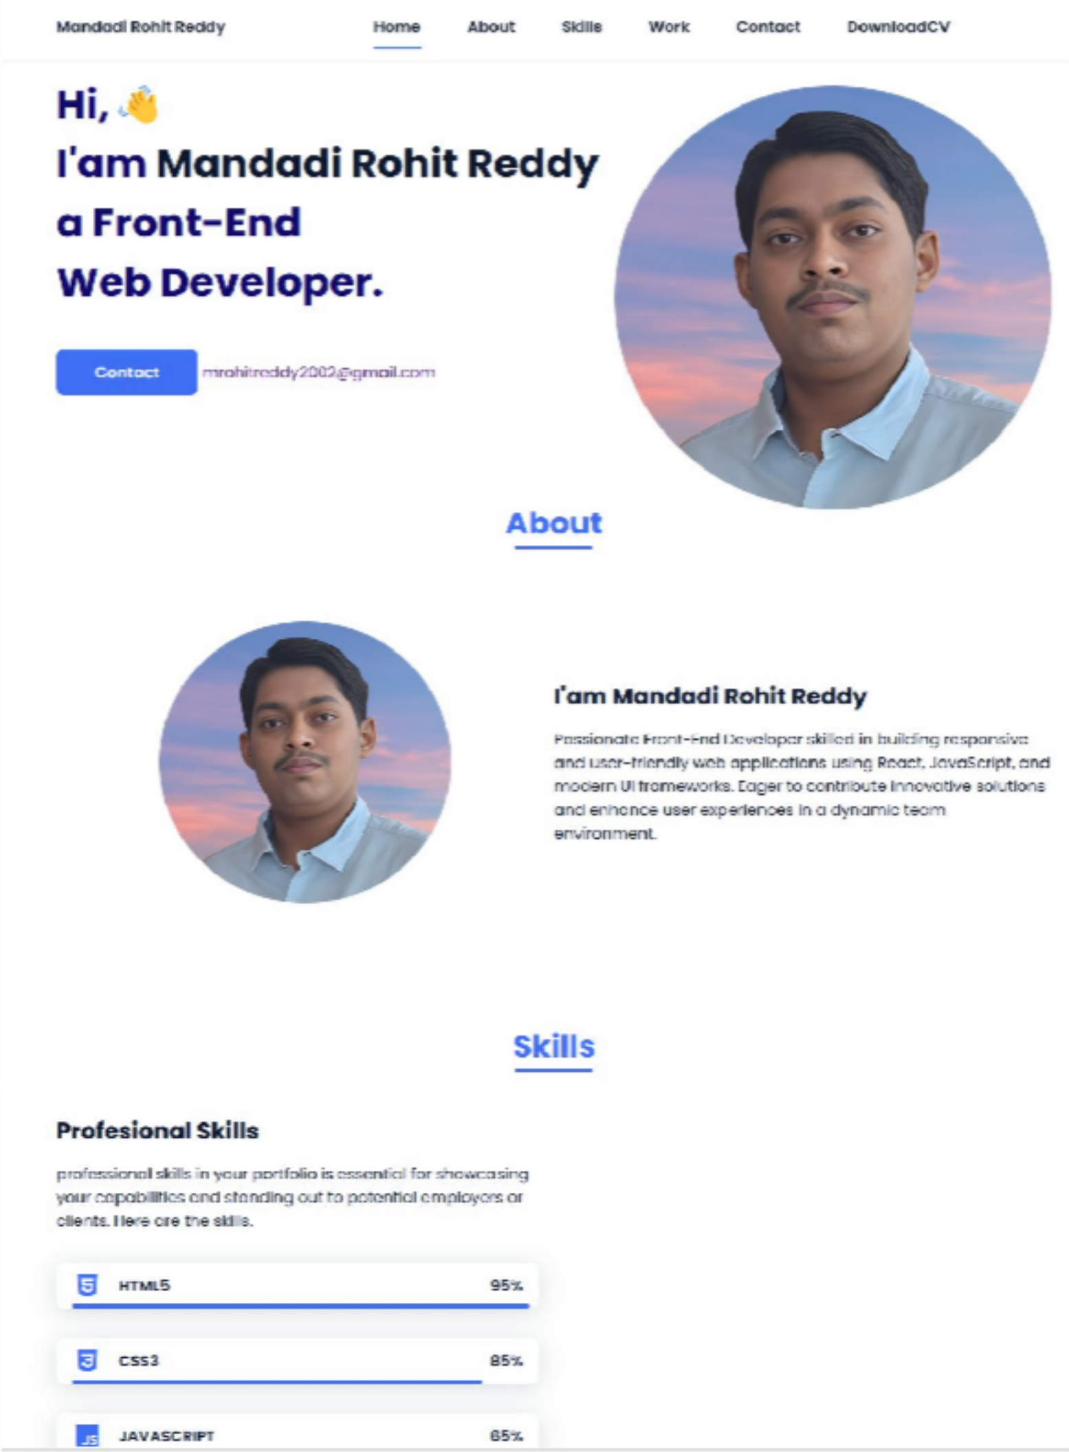
Portfolio: Key Sections & JavaScript Functionality
About Me
Passionate Front-End Developer skilled in building responsive and user-friendly web applications using React, JavaScript, and modern UI frameworks. Eager to contribute innovative solutions and enhance user experiences in a dynamic team environment
Projects
This section showcases my personal and academic projects with descriptions and links to GitHub repositories. Interactive elements, such as image sliders or project filtering, are implemented using JavaScript.
Contact
This section features a contact form for visitors to send messages, along with my email address and social media links.
https://tubular-dango-96730a.netlify.app/

Slide 11
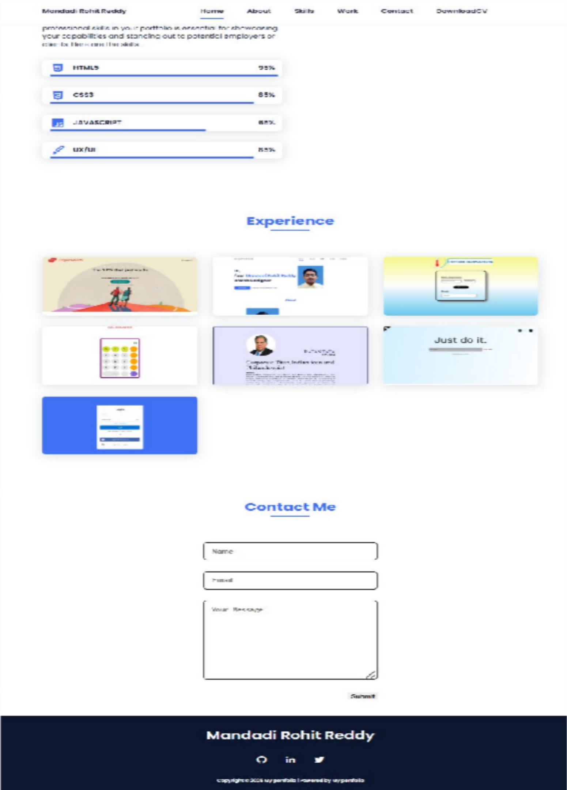
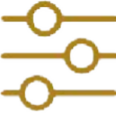


Portfolio: JavaScript Features & Libraries
Interactive elements, such as image sliders, are implemented using libraries like Swiper or Slick, providing smooth transitions between project images.
Project filtering allows visitors to easily browse projects based on specific categories, using JavaScript to dynamically display relevant projects.
Form validation ensures that users enter valid information into the contact form, using JavaScript to validate input fields before submission.
https://tubular-dango-96730a.netlify.app/

Slide 12
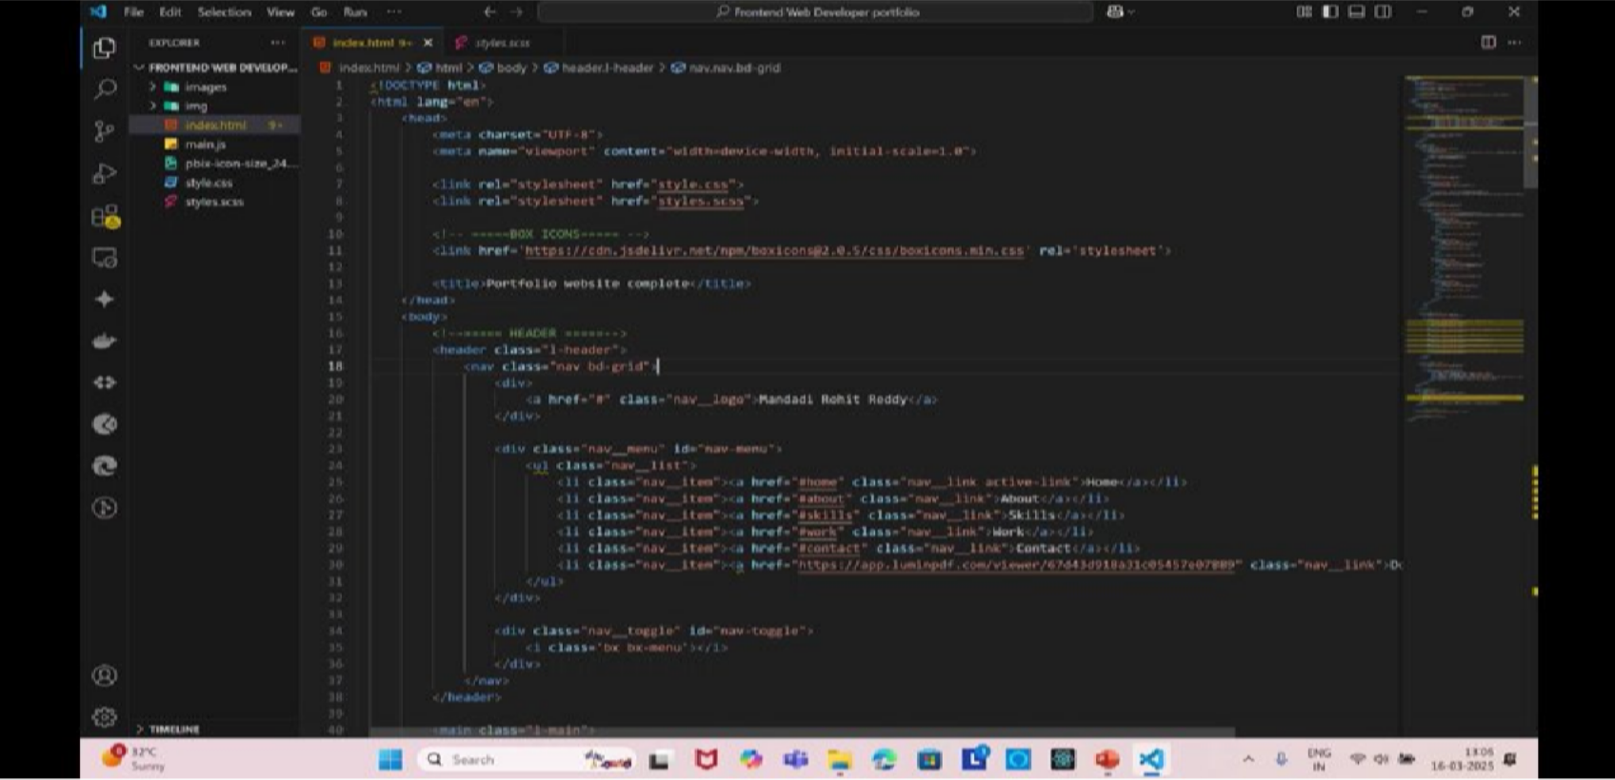
My Portfolio.mp4 (Functionality Video)
https://tubular-dango-96730a.netlify.app/

Slide 13
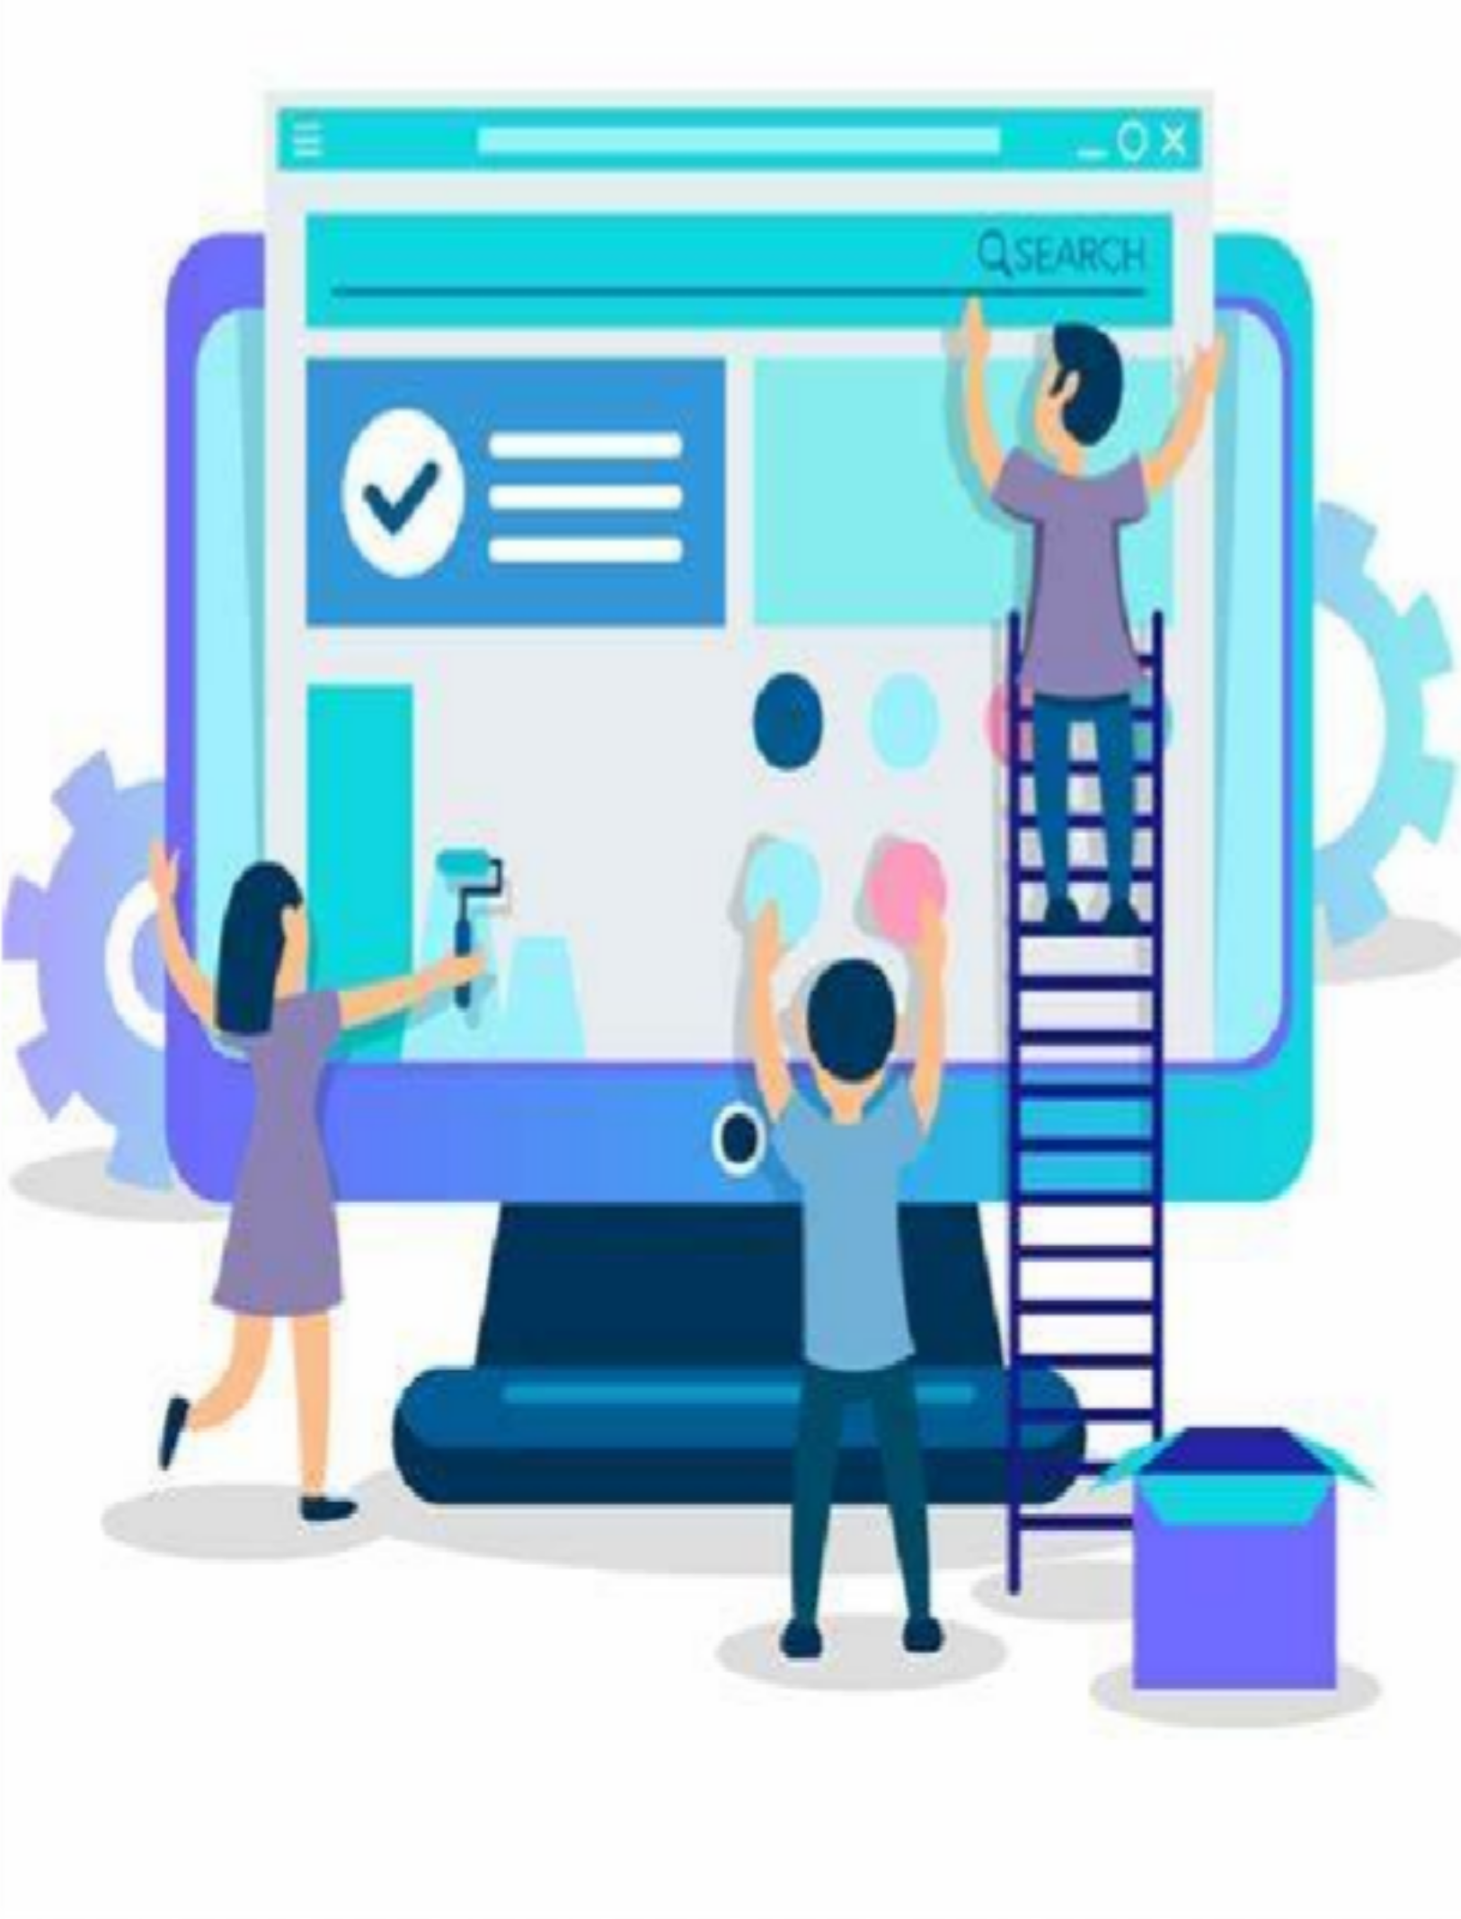
Conclusion & Future Development
This presentation has showcased my ability to create engaging web applications, evident in the Tic-Tac-Toe game and my portfolio website. Future plans include adding advanced features to the game, such as a more sophisticated AI, and expanding my portfolio with new projects and skills. The goal is to continuously improve my skills and build even more innovative and engaging web experiences.
"I look forward to refining my skills further, tackling new challenges, and pushing the boundaries of web development. If you have any feedback or suggestions, I’d love to hear them!"
https://tubular-speculoos-8d8fbc.netlify.app/
https://tubular-dango-96730a.netlify.app/

Slide 14


